Slide 1
Cloud based
Modern Data Warehouse
Framework

Slide 2

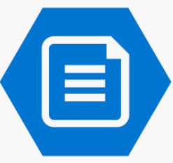


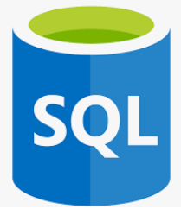
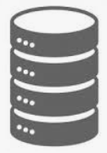









DATA
INTELLIGENCE
ACTION
Source
Use Azure Data Factory for Orchestration from various sources
Azure File Storage
Load XLS/CSV and other text files from mapped disk on Azure File Storage
Unstructured and Semi-structured data
Load from Azure SQL Database
Use Databricks to load data from Databricks
Azure File Storage mapped as a separate disk on On-Premises systems and synchronized
Azure SQL Database
Azure Data Lake
Load data from On-Premises and Azure SQL Database to Data Lake for long term retention
Load from On-Premises SQL Databases
Cloud
Integration Runtime Gateway
On-Premises
Use Gateway installed on On-Premises server to access data from Cloud
Not part of Framework
Part of Framework

Slide 3
Features of ADF Framework
Load data from relational format, text files to Cloud
Can load CSV, TSV, text format
Uses ELT (Extract-Load-Transform) pattern suitable for Cloud
Model data suited for Business Intelligence and Analytics
Configuration based / Less-Code
Standardized Logging
Patterns to maintain History easily (Slowly Changing Dimension)
Easy Deployment and Configuration with ARM Template and Azure CLI
Easy to customize based on requirements
Bulk of heavy lifting of moving data is simple to setup
Meta Data driven Framework
Works with Hybrid environment
Ready for Big Data loads using Azure Databricks

Slide 4
Benefits of ADF Framework
Speed of Implementation
Less Code less error – more maintainable
Time to focus on complex business logic
Repeatable
Helps follow a standard for the client development team

Slide 5








GitHub repository
Create ADF
Deploy ADF ARM Template
Configure Linked Services based on Project Prefix
Create Azure Application, Service Principal
Link App to Azure Data Lake
Add Storage BLOB Data Contributor to Data Lake
Create Azure Data Lake
1
2
Create Azure SQL DB Server
Create empty database for adflab
Deploy bacpac for adflab
Deploy WideWorldImporters sample database
Cloud Shell CLI
Create Azure Key Vault
Add Keys for new resources and based on Parameters
Add Access Policy for Azure App, User, Function App
Add AppId, Secret to Key Vault
Click Deploy to Azure button on GitHub to deploy resources on Azure using ARM template
Create Container Instance
Link to Storage Account
Create Hosting Plan
Deploy ADF ARM Template, database and configure resources
Deploy Azure Function for File Handling from Cloud Shell BLOB Storage
Create Azure Storage
Create default containers
Create default folders on Azure File Storage
Upload sample files for File Handling
Create Data Bricks

Slide 6


Create and update Secret Token
Import notebook from GitHub
Create Cluster
Create Scope for Key Vault
3
Update Access Policy on KeyVault for ADF using Cloud Shell PowerShell
Update Linked Service for File Storage, Azure Function, Databricks
4
Cloud Shell PowerShell
Manual Updates
Add Firewall with IP Address
Use PowerShell to update the Integration Runtime with Key from Data Factory
Add Databricks Token to KeyVault
Add File Service Azure Function Key to KeyVault
Map Disk on Local Computer to allow files to be uploaded to Azure File Storage

Slide 7





1
Create Scope with reference to Key Vault
2
Create a Token
3
Add Security Token to Key Vault
4
Import or Create Notebooks
Databricks Notebook retrieves secret from Azure Key Vault
5
Create Databricks Cluster
Databricks Notebook
Databricks
Azure
5
Update Linked Service with Token and Cluster
Azure Data Factory calls Databricks Notebook
SQL Server Credential retrieved from Key Vault from Databricks Notebook
Databricks Notebook passes the App ID and Key retrieved from Key Vault to Azure App to access Data Lake
With Scope reference and Access Token Databricks gets added to Key Vault Access Policies and is able to retrieve secrets from Key Vault

Slide 8

Load remaining Dimension or Reference data in parallel
Load transactions data in parallel
Dataset with Dependencies. Load sequentially one after another
Product
Customer
Country
State
City
Purchases
Invoice Type
Sales
Other Master data

Slide 9
Customer
Product
Invoice Type
Sales
Other Master data
Geography comprising Country, State and City

